Slide 1


Introduction to Bioinformatics
Study program: Bioprocess Engineering
Elective Module (Wahlpflichtmodul)
9th October to 13th October
Responsible: Prof. Dr. Axel Blokesch, blokesch@fb2.fra-uas.de
by Pablo Riesgo-Ferreiro, TRON gGmbH
pablo.riesgoferreiro@tron-mainz.de
Day 1 - Session 1

Slide 2
Organization of the course
Four days
Three sessions of hour and a half per day, between 9 am and 3 pm
Two practical use cases on days 2 and 3
What you‘ll need:
a computer (any system is fine: Windows, Mac, Linux, ...)
internet access and your favourite web browser
a free GitHub account
Final exam on 18th October
If you have participated actively in the course and worked on the practical use case you are allowed to use your written records in the final exam an complete tasks related to these cases with a rating of 15 % (case 1) and 25 % (case 2). If you did not edit these practical use cases (or only one of them), you have to complete another task in the exam instead.
Please, do interrupt me at any time. Your questions are always welcomed

Slide 3
Presentations - who are you?
Your name?
Why are you interested in bioinformatics?
What would you want to learn in this course?
What are your professional goals?
Do you have a computer with you?
Start thinking on these answers, you will have to answer in two slides

Slide 4
Presentations - who am I?
Bioinformatics scientist @ TRON gGmbH Computational Medicine since 2019
Bioinformatician since 2012
Professional software engineer since 2007
Double Master degree in Computer Science (2008) and in Bioinformatics and Biostatistics (2011)
Worked in five countries, from startups to large multinationals to research institutes
I am skilled with computers and mathematics and love to apply these skills to biological problems and learn as much biology as I can
I do not have practical experience in the wet lab!
My daily routine involves analysing new data (20 %), generating new data applying computational methods (20 %), developing new methods (40 %)

Slide 5
Presentations - what is TRON gGmbH?
TRON gGmbH, the institute for Translational Oncology and Immunology is a new rapidly growing biopharmaceutical non-profit research institute seeking to diagnose and treat unmet medical needs through novel therapies
Funded in 2010 by Ugur Sahin, Christoph Huber and Özlem Türeci https://www.tron-mainz.de/
TRON is located in Mainz, Germany, has strong connection to start-up HI-TRON, the University of Mainz and Biontech SE and is developing novel platforms for therapies and biomarkers
At TRON there is a strong emphasis in training the new generation of scientists. We have in our team master students, student assistants (Hilfswissenschaftler) and finally PhD students
The ATLAS program is a joint PhD program between Biontech and TRON https://atlas-phdprogram.com/
The team is growing https://tron-mainz.de/de/karriere#job-openings !!

Slide 6
Presentations - who are you?
Your name?
What are your professional goals?
Why are you interested in bioinformatics?
What would you want to learn in this course?
Do you have a computer with you?

Slide 7
Objectives of the course
Overview of what is bioinformatics, why it is needed now and what are its perspectives for the future
Rudiments of mainstream tools in bioinformatics
Initiation to Nextflow workflow manager
...

Slide 8
Course overview

Slide 9
Outline of this session
Definition of bioinformatics and computational biology
Skills and routine of a bioinformatician
Programming in bioinformatics
Bioinformatics most popular resources
Brief history of bioinformatics

Slide 10
Definition of bioinformatics (... and his cousin computational biology)
Collins Concise English Dictionary
bioinformatics /ˌbaɪəʊˌɪnfəˈmætɪks/n (functioning as singular)
1. the branch of information science concerned with large databases of biochemical or pharmaceutical information
Wikipedia
bioinformatics /ˌbaɪ.oʊˌɪnfərˈmætɪks/
is an interdisciplinary field of science that develops methods and software tools for understanding biological data, especially when the data sets are large and complex. Bioinformatics uses biology, chemistry, physics, computer science, computer programming, information engineering, mathematics and statistics to analyze and interpret biological data. The subsequent process of analyzing and interpreting data is referred to as computational biology.

Slide 11
Bioinformatics or computational biology (let‘s ask the robot)
ChatGPT (3.5) what is the difference between bioinformatics and computational biology?
Bioinformatics and computational biology are closely related fields, but they have distinct focuses and areas of emphasis:
1. Bioinformatics:
- Bioinformatics primarily deals with the development and application of software tools and databases for managing, analyzing, and interpreting biological data, particularly molecular data like DNA, RNA, and protein sequences.
- It involves tasks such as sequence alignment, phylogenetic analysis, structure prediction, and functional annotation.
- Bioinformatics is more focused on the computational and informatics aspects of biological data, often involving the storage and retrieval of large datasets.
2. Computational Biology:
- Computational biology is a broader field that encompasses the use of computational methods and models to understand biological processes and systems.
- It includes the development of mathematical and computational models to simulate biological phenomena and gain insights into how living systems function.
- Computational biology can involve a wider range of biological data, including genomics, proteomics, systems biology, and more.
- It often emphasizes the development of algorithms and mathematical models to address biological questions.
In summary, while bioinformatics is a subset of computational biology, it mainly focuses on data management and analysis, whereas computational biology has a broader scope, encompassing the development of computational models and simulations to study biological systems. These fields often overlap and collaborate to advance our understanding of biology and address complex biological questions.

Slide 12
Bioinformatics or computational biology (let‘s ask the other robot)
ChatGPT (4.0) what is the difference between bioinformatics and computational biology?
Bioinformatics and computational biology are distinct disciplines that scientists can use to help manage and understand biological data. Here are some of the main differences between the two:
Computational Biology uses computer science, statistics, and mathematics to solve problems in biology. It can involve the development of algorithms, theoretical models, computational simulations, and mathematical models for statistical inference. Computational biology concerns all the parts of biology that aren’t wrapped up in big data. It is most effective when dealing with smaller, specific data sets and answering more general biological questions.
Bioinformatics is a multidisciplinary field that combines biological knowledge with computer programming and big data. It is particularly useful when dealing with large amounts of data, such as genome sequencing. Bioinformatics requires programming and technical knowledge that allows scientists to gather and interpret the results of more complex analyses.
While there is a great deal of overlap between computational biology and bioinformatics, the latter focuses more on big data and requires programming skills to handle and analyze large datasets.
The lines between computational biology and bioinformatics continue to blur, and most scientists use both at various points when dealing with biological data.

Slide 13
Bioinformatics or computational biology
“This duality echoes another that goes back to Aristotle, between ‘‘episteme’’ (knowledge, especially scientific) and ‘‘techne’’ (know-how, in the sense of craft or technology).” (Searls, 2010)
The subject area of Nature journals use the term interchangeably (Russell, 2018)
„Computational biology and bioinformatics is an interdisciplinary field that develops and applies computational methods to analyse large collections of biological data, such as genetic sequences, cell populations or protein samples, to make new predictions or discover new biology. The computational methods used include analytical methods, mathematical modelling and simulation.“
https://www.nature.com/subjects/computational-biology-and-bioinformatics

Slide 14
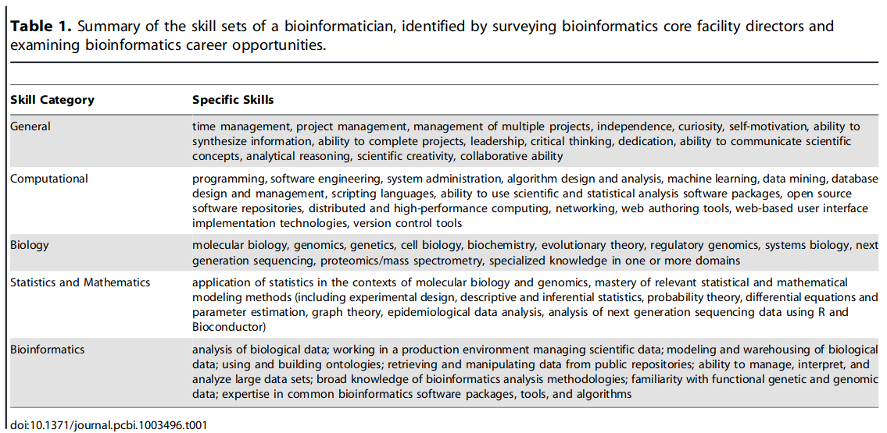
Skills needed by a bioinformatician
this course will touch on
(Welch, 2014)

Slide 15
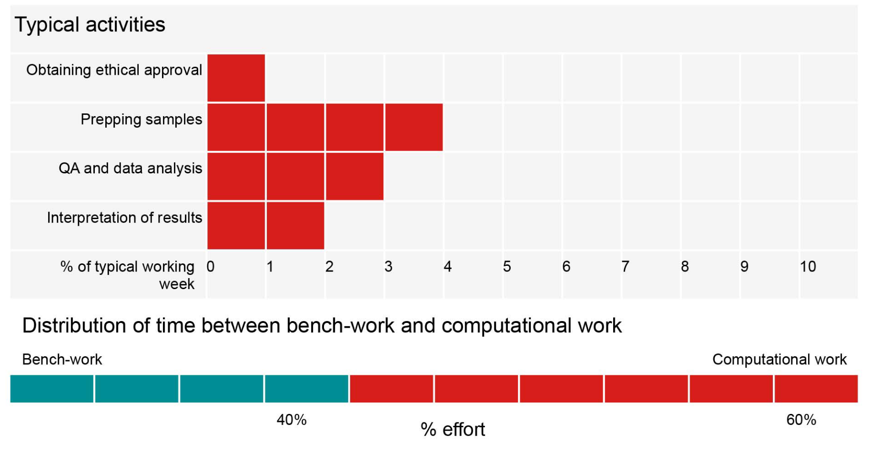
Bioinformatics user persona (Welch, 2014)

Slide 16
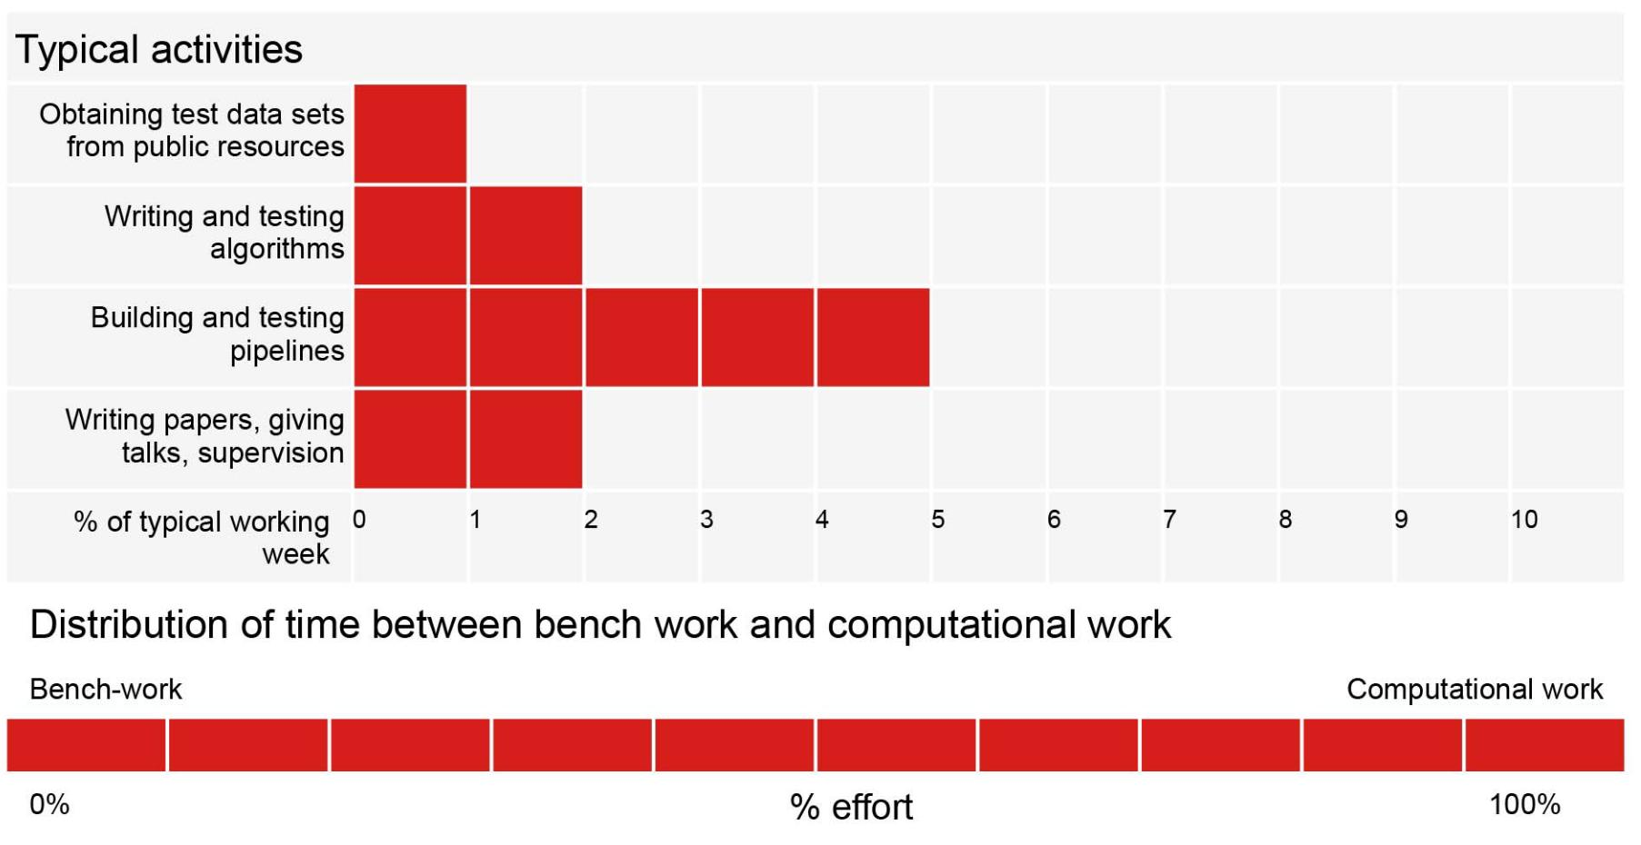
Bioinformatics scientist persona (Welch, 2014)

Slide 17
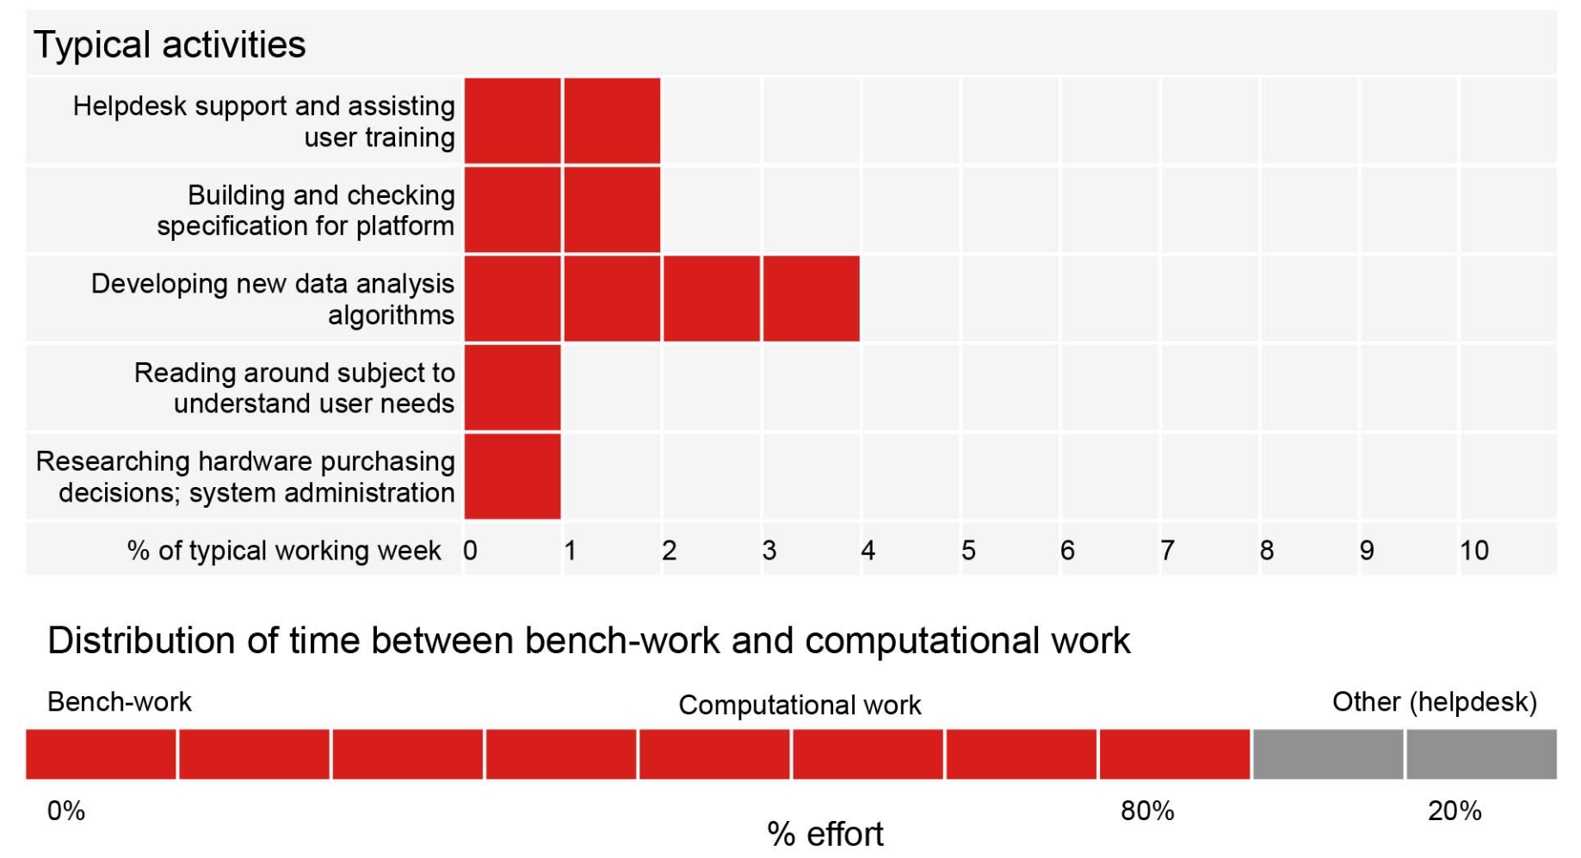
Bioinformatics engineer persona (Welch, 2014)

Slide 18
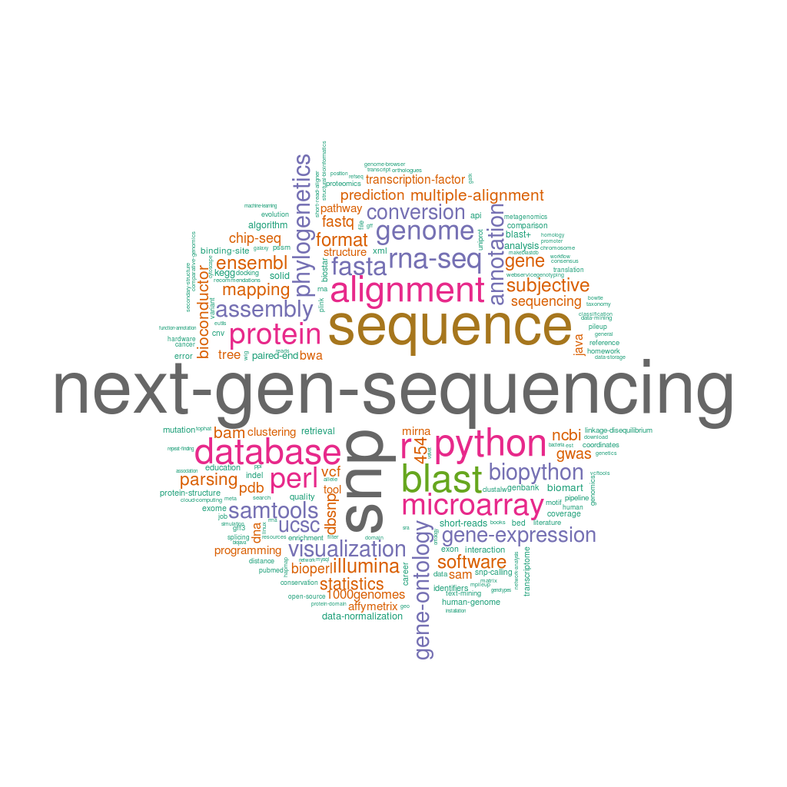
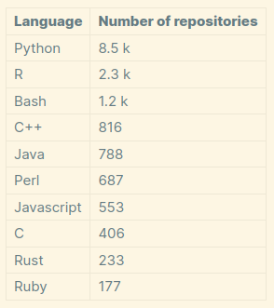
Most popular programming languages and topics in bioinformatics
This obviusly changed and changes throughout time
At the moment the winner is Python, although it may not be the fastest it prioritizes readability
Open source repositories in GitHub labelled with the keyword „bioinformatics“. This is just intended for illustrative purposes,
these numbers are an underestimation of existing bioinformatics code
e.g.: https://github.com/search?q=bioinformatics+language%3A%22javascript%22&type=repositories
NSAUNDERS. Popular topics at the BioStar Q&A site. What You’re Doing Is Rather Desperate https://nsaunders.wordpress.com/2011/08/23/popular-topics-at-the-biostar-qa-site/ (2011).

Slide 19
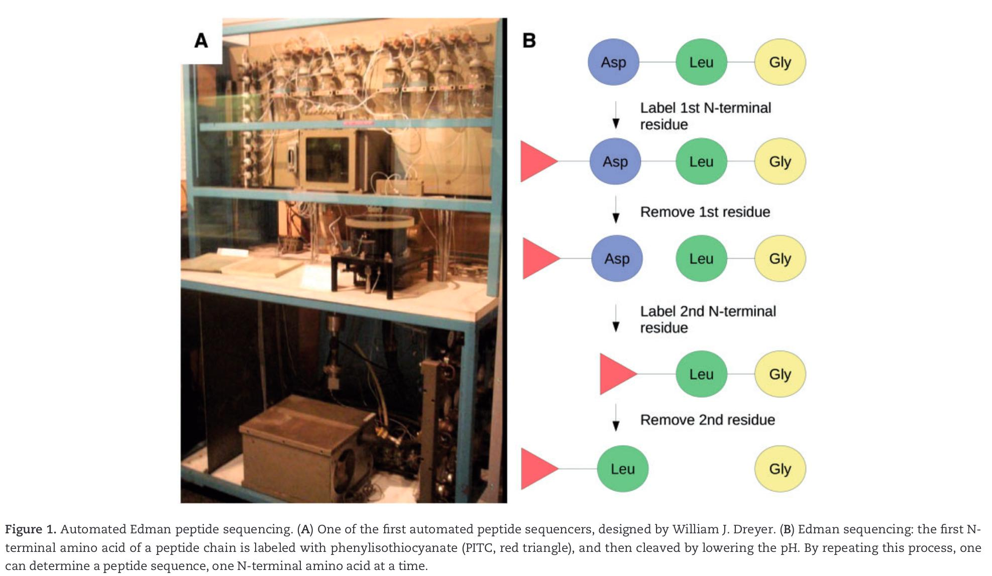
Brief history of bioinformatics 1950-1970: the origins
Insulin was the first sequenced protein with the Edman degradation method
Larger proteins could not be sequenced, but rather splitted and then sequenced. But then how do you put the pieces back together?
(Gauthier, 2019)

Slide 20
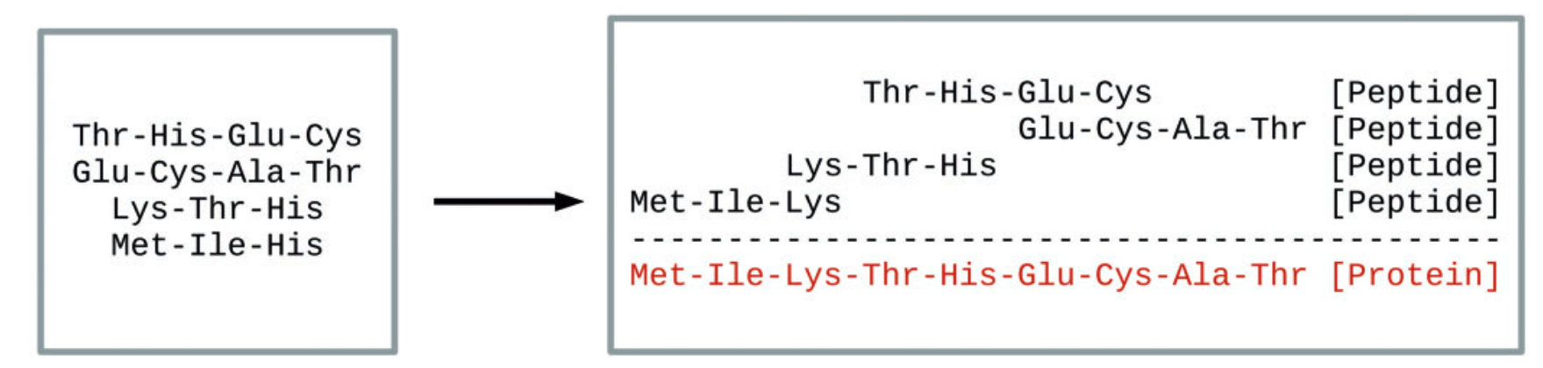
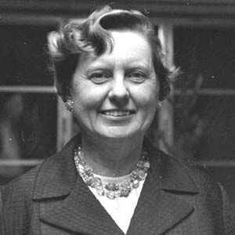
Brief history of bioinformatics 1950-1970: the origins
(Gauthier, 2019)
Margaret Dayhoff (1925–1983) developed the first bioinformatics program, COMPROTEIN, that determined a protein primary structure from Edmon‘s sequencing data
Nowadays, we call this algorithm a de novo sequence assembler
It was coded in FORTRAN on punch cards!

Slide 21
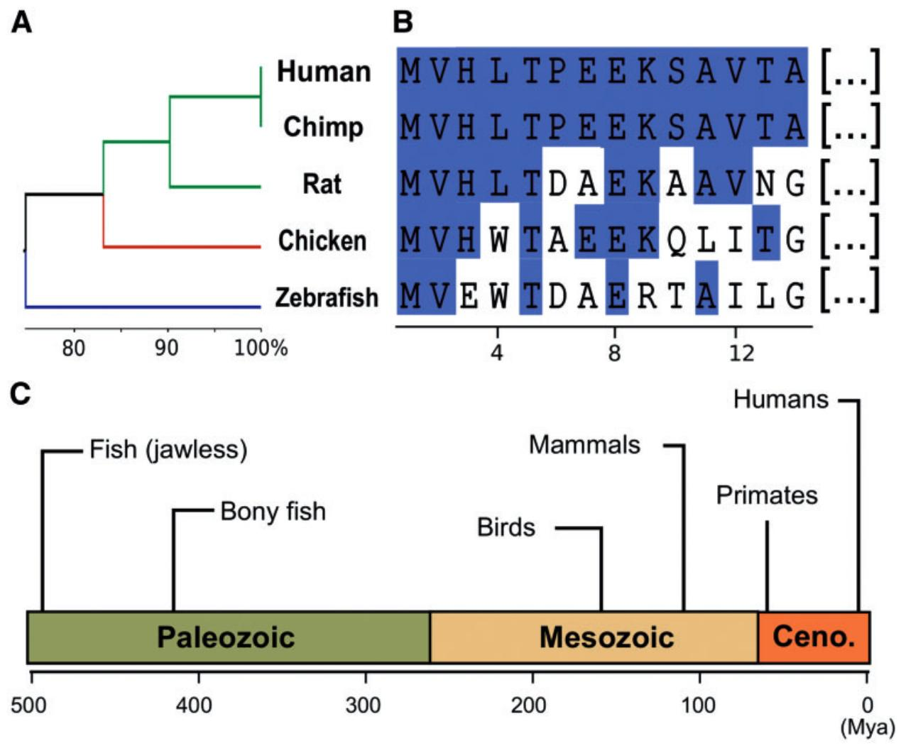
Brief history of bioinformatics 1950-1970: the origins
In 1963 the term paleogenetics was coined, and the concept of orthology was defined in 1970. The amount of differences in orthologs from different species seemed proportional to the evolutionary divergence between those species.
But there was no algorithm to identify the differences between two sequences, until Needleman-Wunsch developed their pairwise protein sequence alignment.
This algorithm was later extended to Multiple Sequence Alignment (MSA) and later on implemented in CLUSTAL which is still in use today.
(Gauthier, 2019)

Slide 22
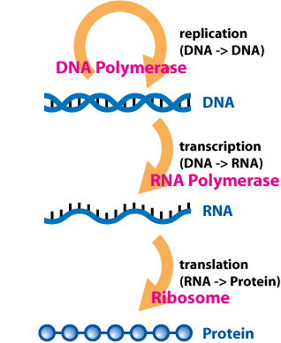
Brief history of bioinformatics 1970-1980: paradigm shift from protein to DNA analysis
In 1958 Crick defined the central dogma of biology
In 1968 all 64 DNA codons were deciphered
In 1977 Sanger developed his first sequencing method which evolved later into the method still considered the gold standard
The bacteriophage phiX174 genome (5386 bp) was the first whole genome ever sequenced
In 1979 Staden published the Staden package (http://staden.sourceforge.net/), a toolset to manipulate Sanger sequencing readouts
Typical bioinformatic problems at the time:
Finding homology between sequences
Building phylogenetic trees using substitution matrices
Finding Open Reading Frames to identify genes
https://en.wikipedia.org/wiki/Central_dogma_of_molecular_biology

Slide 23
Brief history of bioinformatics 1980-1990: parallel advances in biology and computer science
Gene cloning through recombinant DNA and the Polymerase Chain Reaction (PCR) enabled a better DNA library preparation process
The first „minicomputers“ entered the consumer market in 1977
Commodore PET, Apple II and Tandy TRS-80
These were programmed in Basic or Pascal
These coexisted with larger mainframes running UNIX still used to process larger datasets that were usually using FORTRAN and C
From 1984 to 1985 several software suites to manipulate sequencing data were developed (e.g.: GCG software suite, DNASTAR)
In 1985 Stallman published the GNU manifesto which later evolved into the Free Software Foundation
In the early 1980s the first desktop computers arrived with the x86 and RISC architectures
These were the size of microcomputers, but they ran UNIX and were as performant as mainframes
This fostered the creation of interpreted languages
In 1987 PERL (Practical Extraction and Reporting Language) was created anf the first bioinformatics Perl code dates from 1994. Perl dominated bioinformatics until late 2000s with bioperl
In 1989 Python was created with an emphasis on code readability and now dominates the bioinformatic software
Importantly in 1986 and 1987 the European Molecular Biology Laboratory (EMBL), GenBank from the US and DNA Data Bank of Japan (DDBJ) sequence databases united into what is today the International Nucleotide Sequence Database Collaboration (INSDC)
This fostered data sharing and format standardizing at a global scale
In 1985 the specialized journal Computer Applications in the Biosciences (CABIOS) was established. This later evolved in today‘s Bioinformatics journal

Slide 24



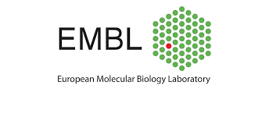

Brief history of bioinformatics 1990-2000: genomics, structural bioinformatics and the information superhighway
In 1990 Tim Berners Lee developed the Internet and started a never before seen data and software sharing in the scientific world
In 1991 the first preprint server arXiv was implemented and followed by bioarXiv in 2013
In 1993 the first nucleotide sequence database was made publicly available online, the EMBL Nucleotide Sequence Data Library
In 1994 the NCBI‘s GenBank database became online from their original printed and CD-ROM format
Bioinformatic tools become widely available through online servers usable via a graphical interface
In 1995, the first complete genome sequencing of a free-living organism (Haemophilus influenzae) was sequenced by The Institute for Genomic Research (TIGR) led by geneticist J. Craig Venter
GPU computation aides in first attempts to molecular dynamycs simulations

Slide 25
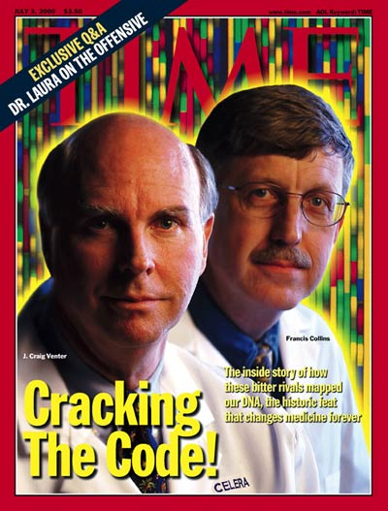
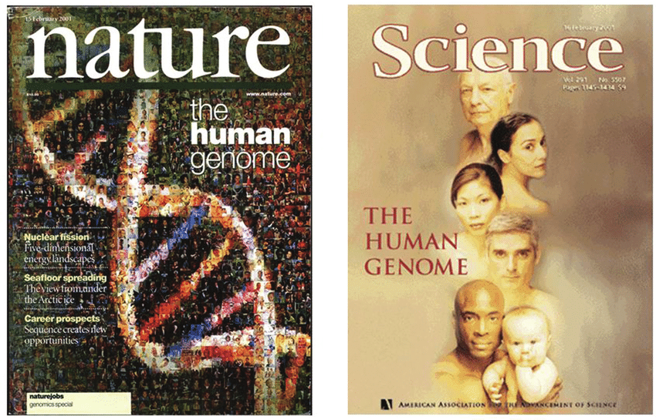
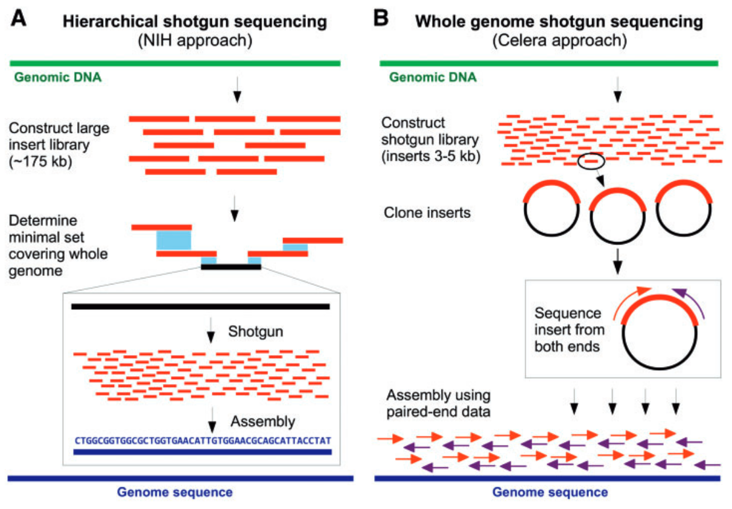
Brief history of bioinformatics 1991-2003: the Human Genome Project
The Human Genome Project was initiated in 1991 by the U.S. National Institutes of Health (NIH), and cost $2.7 billion in taxpayer money (in 1991 dollars) over 13 years. Competed with a private effort by TIGR. Both lead to the publication of the „complete“ human genome in 2003
This project was completed based solely in first generation sequencing methods (ie: Sanger sequencing)
Bioinformatics played a key role in the HGP in the assembly of all generated sequences
Several pioneer Perl programs were developed for this purpose
PHRAP
Celera Assembler
TIGR Assembler
MIRA
EULER
(Gauthier, 2019)

Slide 26
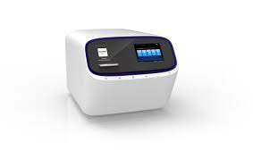
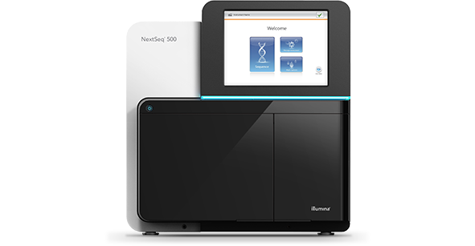
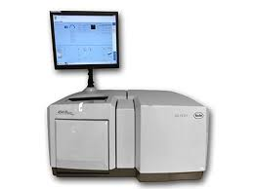

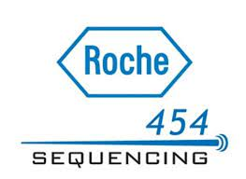

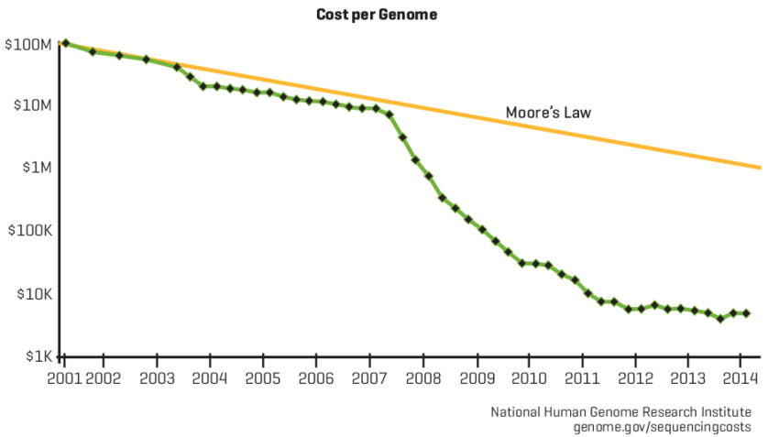
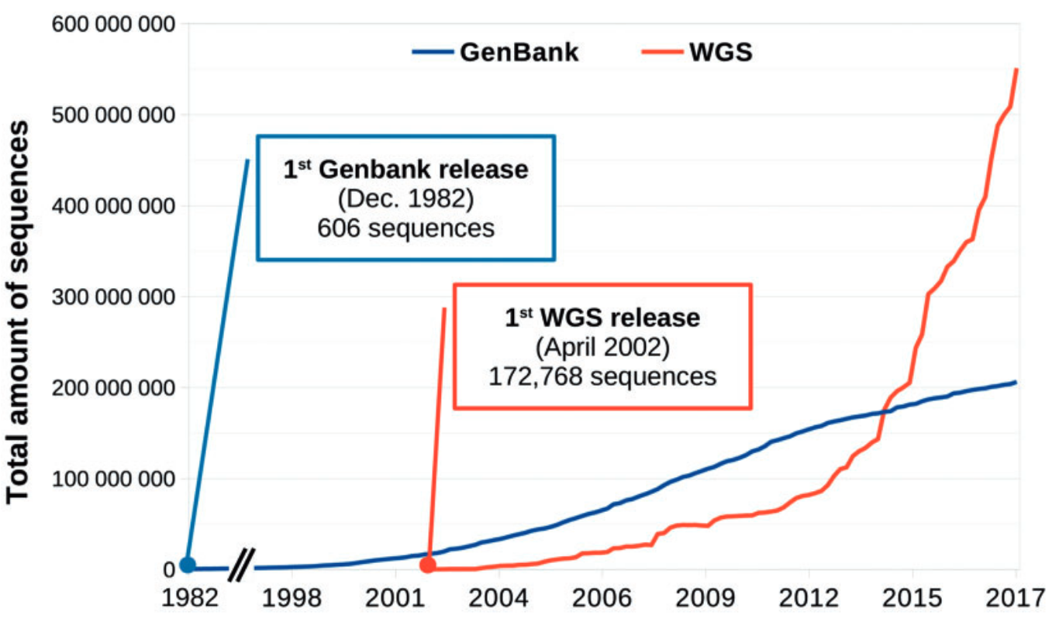
Brief history of bioinformatics 2000-2010: high-throughput bioinformatics
In 2005 Second generation sequencing (also known as Next Generation Sequencing, NGS) introduced massively parellel sequencing and democratized sequencing
In 2008 the decrease in price of sequencing beyond the Moore‘S law led to the exponential increase in available sequences
The appearance of Biological Big Data see the apparition of several dedicated databases to enable reproducibility of results
European Nucleotide Archive (ENA)
Sequence Read Archive (SRA)
Genomic data standards become equally important and the Genomic Standards Consortium is created in 2005
High Performance Computing (HPC) becomes increasingly important to perform bioinformatics research
(Gauthier, 2019)

Slide 27
Brief history of bioinformatics 2000-today: large genomic initiatives
The 1000 Genomes Project (1KGP) was an international research effort launched in January 2008 with the goal of creating the most detailed catalogue of human genetic variation1. The project aimed to find common genetic variants with frequencies of at least 1% in the populations studied
The International HapMap Project was an organization that aimed to develop a haplotype map (HapMap) of the human genome, to describe the common patterns of human genetic variation. The project was conducted in great intensity from about 2003 to 2006.
The Encyclopedia of DNA Elements (ENCODE) is an ongoing international collaboration of research groups funded by the National Human Genome Research Institute (NHGRI)1. The goal of ENCODE is to build a comprehensive parts list of functional elements in the human genome, including elements that act at the protein and RNA levels, and regulatory elements that control cells and circumstances in which a gene is active.
100,000 Genomes Project: This British initiative, overseen by Genomics England, aimed to sequence 100,000 genomes from around 85,000 NHS patients affected by rare disease or cancer2. The project was completed in December 2018.
Genotype-Tissue Expression Project (GTEx): This project aims to provide the scientific community with a resource to study how genetic variation affects gene expression in human tissues.
Human Microbiome Project (HMP): This project aims to characterize the microbial communities found at several different sites on the human body and to analyze their role in human health and disease.
1+ Million Genomes Initiative: This European initiative aims to enable secure access to genomics and corresponding clinical data across Europe for better research, personalized healthcare, and health policy making.
All of Us Research Program: This program by the National Institutes of Health (NIH) in the United States aims to gather data from one million people living in the United States to accelerate research and improve health.
Trans-Omics for Precision Medicine (TOPMed) program: An NIH initiative that generates scientific resources to enhance our understanding of fundamental biology and disease mechanisms.
Genomic Encyclopedia of Bacteria and Archaea (GEBA) projects: These projects aim to fill in missing branches of the tree of life by sequencing a diverse set of bacteria and archaea.
1000 Fungal Genomes Project: This project aims to explore the diversity of fungi that inhabit our planet.
... and many more...

Slide 28


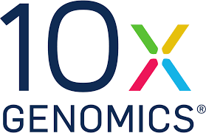
Brief history of bioinformatics 2010-today: data heterogeneity explosion
Long read sequencing (third generation sequencing) enables for a better identification of certain genomic events not „visible“ with short reads
Single cell techniques enable to apply several other genomic techniques at single cell resolution (eg: scRNAseq, scBisulfiteSeq)
Epigenomics
BisulfiteSeq determines the pattern of methylation on DNA
ChIP-seq (Chromatin Immuno Precipitation) and ATACseq determines histone modifications
Metagenomics, enables the study of environmental samples with mixed populations
3D genomics enable the study of the threedimensional conformation of the genome using Hi-C techniques
Genome editing (CRISPR-Cas9) allows to apply arbitrary genomic modifications with high fidelity
Spatial transcriptomics enable the differential expression of genes at subcellular level within tissues
Paleogenomics enable the study of extinct species or ancient human remains
Multi-omics analysis, with such an availability of different biological readouts the integration of multiple and hetereogenous sources of data is increasingly a challenge
Population wide studies and repositories, as the amount of collected data grows it enables population wide studies and landscapes not possible before
Artificial intelligence in genomics, as in other fields AI is having an increasing role. Machine Learning has long been used in bioinformatics methods (see AlphaFold (Jumper, 2021)) and the first applications of Large Language Models (LLMs) are starting to appear

Slide 29
Bibliography and further reading
Russell, P. H., Johnson, R. L., Ananthan, S., Harnke, B. & Carlson, N. E. A large-scale analysis of bioinformatics code on GitHub. PLoS ONE 13, e0205898 (2018).
Searls, D. B. The Roots of Bioinformatics. PLOS Computational Biology 6, e1000809 (2010).
Welch, L. et al. Bioinformatics Curriculum Guidelines: Toward a Definition of Core Competencies. PLOS Computational Biology 10, e1003496 (2014).
Vincent, A. T. & Charette, S. J. Who qualifies to be a bioinformatician? Frontiers in Genetics 6, (2015).
Gauthier, J., Vincent, A. T., Charette, S. J. & Derome, N. A brief history of bioinformatics. Briefings in Bioinformatics 20, 1981–1996 (2019).
Jumper, J. et al. Highly accurate protein structure prediction with AlphaFold. Nature 596, 583–589 (2021).
Add all the reference from the large projects

